Slide 1
Session – 1
SOFTWARE

Slide 2
What is Software
INTRODUCTION
Software is:
instructions (computer programs) that when executed provide desired features, function, and performance; .
Software is a set of instructions, data or programs used to operate computers and execute specific tasks

Slide 3
Characteristics of S/W
1.Software is developed or engineered, it is not manufactured in the classical sense.
Software is logical and hardware is physical entity. Both activities require the construction of a “product,” but the approaches are different

Slide 4
2.Software doesn't "wear out." but it deteriorates
Hardware effected by heat ,dust etc., ,software does not effected by environmental conditions
3.Although the industry is moving toward component-based construction, most software continues to be custom-built.
A software component should be designed and implemented so that it can be reused in many different programs

Slide 5
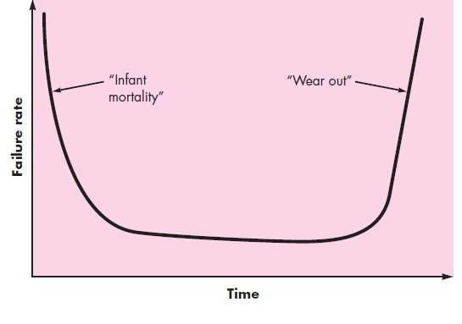
Failure curves for hardware

Slide 6
Wear vs. Deterioration
Failure curves for software

Slide 7
Nature of Software
Software is a Product
Transforms information- produces, manages, acquires, modifies, displays or transmits information
Delivers computing potential of hardware and networks
Software is a vehicle for delivering a product
Controls other programs (operating system)
Effects communications (networking software)
Helps build other software (software tools & environments)

Slide 8
Software Application
Domains

Slide 9
Software Application Domains- 7
System software
Application software
Engineering/scientific software
Embedded software
Product-line software
WebApps (Web applications)
AI software

Slide 10
System software—a collection of programs written to service other programs.
Some system software (e.g., compilers)
Application software—stand-alone programs that solve a specific business need.
(e.g., Ticket booking from irctc,Passport application ,real-time manufacturing process control).
Engineering/scientific software—has been characterized by “number crunching” algorithms
(e.g., Computer-aided design, system simulation,
and other interactive applications)

Slide 11
Embedded software—resides within a product or system and is used to implement and control features
e.g., key pad control for a microwave oven)
Product-line software—designed to provide a specific capability for use by many different customers. (e.g., word processing, spreadsheets
Web applications—called “WebApps,” this network-centric software (e.g., True caller.. etc)
Artificial intelligence software—makes use of nonnumerical algorithms to solve complex problems (e.g., game playing etc)

Slide 12
Software - New Challenges
Open world computing—pervasive, distributed computing
Ubiquitous computing—wireless networks
Net sourcing—the Web as a computing engine-Need target marketing
Open source—”free” source code open to the computing community

Slide 13
Legacy Software
older programs—often referred to as legacy software
They were developed decades ago and have been continually modified to meet changes in business requirements
one additional characteristic that is present in legacy software—poor quality
a legacy system must be reengineered

Slide 14
legacy systems often evolve for one or more of the following reasons:
The software must be adapted to meet the needs of new computing environments or technology.
The software must be enhanced to implement new business requirements.
The software must be extended to make it interoperable with other more modern systems or databases.
The software must be re-architected to make it viable within a network environment.

Slide 15
Unique Nature of WebApps
Network intensiveness. A WebApp resides on a network and must serve the needs of a diverse community of clients.
Concurrency. A large number of users may access the WebApp at one time.
Unpredictable load. The number of users of the WebApp may vary by orders of magnitude from day to day.
Performance. If a WebApp user must wait too long (for access, for server-side processing, for client-side formatting and display), he or she may decide to go elsewhere.
Availability. Although expectation of 100 percent availability is unreasonable, users of popular WebApps often demand access on a “24/7/365” basis.

Slide 16
Unique Nature of WebApps
Data driven. The primary function of many WebApps is to use hypermedia to present text, graphics, audio, and video content to the end-user.
Content sensitive. The quality and aesthetic nature of content remains an important determinant of the quality of a WebApp.
Continuous evolution. Unlike conventional application software that evolves over a series of planned, chronologically-spaced releases, Web applications evolve continuously.
Immediacy. Although immediacy—the compelling need to get software to market quickly—is a characteristic of many application domains, WebApps often exhibit a time to market that can be a matter of a few days or weeks.
Security. Because WebApps are available via network access, it is difficult, if not impossible, to limit the population of end-users who may access the application..
End of session - 1

Slide 17
Questions
Define Software.
2. What is Bathtub curve.
What are Characteristics of S/W.
What are different Software Application Domains.
Advantages of Software

